Slide 1
CS 670 IC
RESEARCH PROJECT
SECURED VIRTUAL NETWORK – REPOSITORY FOR HUMAN RESOURCE MANAGEMENT SYSTEM
NCORP
ADVISOR: GREG KYRYTSCHENKO
NORI ROSHAN SHARMA
MS CYBER SECURITY

Slide 2
CONTENTS
INTRODUCTION
PROBLEM STATEMENT
DESIGN PLAN
PICTORIAL APPROACH
ISSUES TO BE ADDRESSED
SOLUTION
BUSINESS RULES
WEB APPLICATION FUNCTIONAL DECOMPOSITION, USECASE DIAGRAMS
ERD
WEBSITE
OWASP ESAPI TESTING
FUTURE ENHANCEMENTS
CONCLUSION

Slide 3
DISCUSSION
With Bill: Illegal Immigrants

Slide 4
Accounting frauds
SOX COMPLIANCE

Slide 5
Human Resource management Fraud

Slide 6


Slide 7


Slide 9
INTRODUCTION
NCORP
A SECURED VIRTUAL NETWORK – HUMAN RESOURCE MANAGEMENT SYSTEM
AIMED TO MAINTAIN THE COMPANY, SCHOOL, EMPLOYEE AND STUDENT PERSONAL PROFILES TO MAINTAIN THE INTEGRITY OF HUMAN RESOURCES

Slide 10
PROBLEM STATEMENT
DATA & IT ASSETS ARE AT RISK ( GOAL OF SECURITY IS TO ENSURE CIA )
PAPER WORK AT THE SCHOOLS & SMBs LEADS TO:
RISK OF LOSING (CIA) SECURITY PARAMETERS
More Paper usage
Less Physical Security
Time Delay
More physical work
Time, Money and Resources

Slide 11
PLAN
INFRASTRUCTURE, HOSTING, DEVELOPMENT, TESTING, SECURITY
NCORP

Slide 12
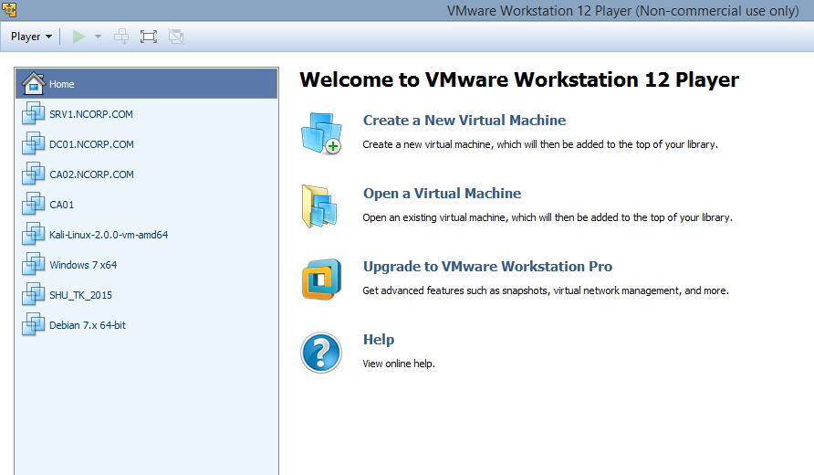

Slide 13
PICTORIAL APPROACH TO SECURITY
INFRA
DATA
NETWORK
PPT
VULNERABILITY MANAGEMENT THROUGH CONTINOUS MONITORING
PPT –PEOPLE PROCESS TECHNOLOGY

Slide 14
DC01 – DOMAIN CONTROLLER , DNS SERVER
SRV1 – WEB SERVER, Web Application Design
CA01 – CERTIFICATE AUTHORITY
KALI – FOR VULNERABILITY ASSESSMENTS

Slide 15
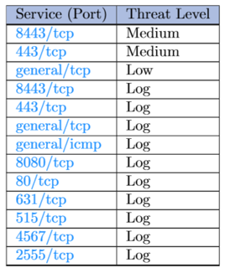
VULNERABILITIES: SRV1

Slide 16
SECURITY ISSUES
RECONNAISSANCE, System Enumeration, web server enumeration, web application enumeration, Active discovery, DOS, Brute Force Attack,, OPENVAS SCANNING REPORTS

Slide 17
SECURITY ISSUES
Reconnaissance, Active discovery, PING OF DEATH, fingerprinting ( WITH NETCAT SESSION )

Slide 18
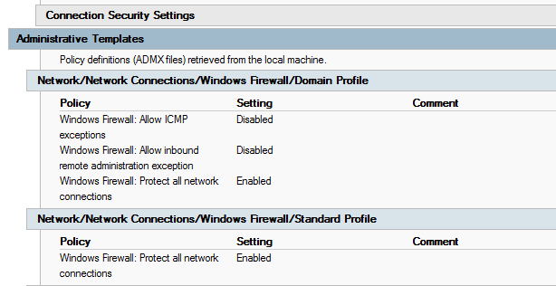
SECURITY MEASURES:
1) RECONNAISSANCE, ACTIVE DISOVERY, PING OF DEATH

Slide 19
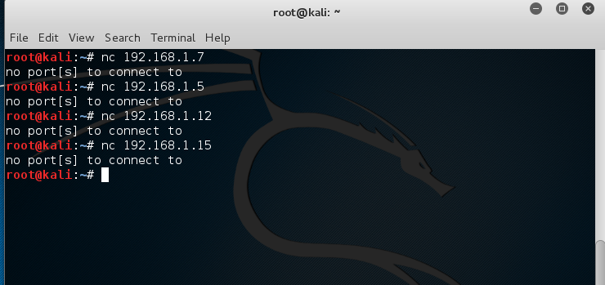
FINGER PRINTING WEB SERVERS FROM KALI

Slide 20
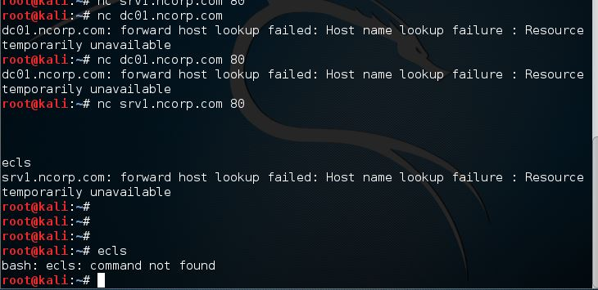

Slide 21
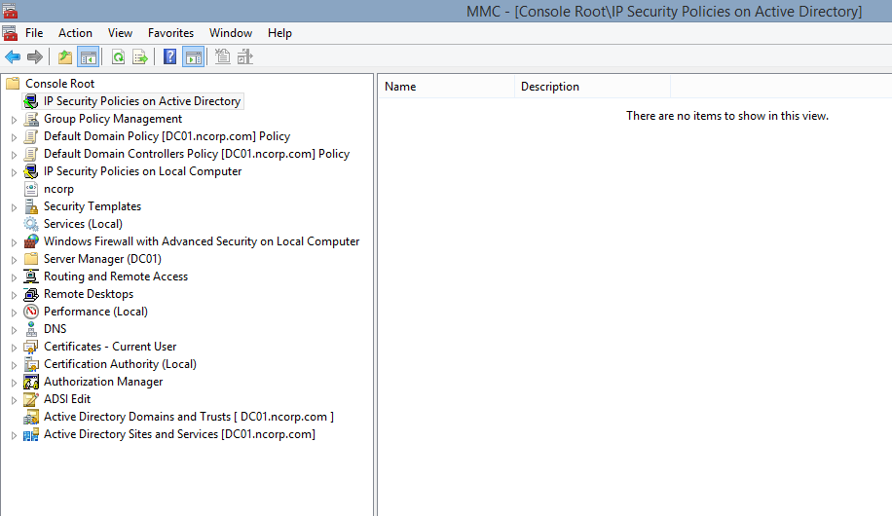
SOLUTION :
MY ADMINISTRATIVE CONSOLE FOR CONTINOUS MONITORING

Slide 22
VM
DC01 for MANAGEMENT CONSOLE: Continuous monitoring

Slide 23
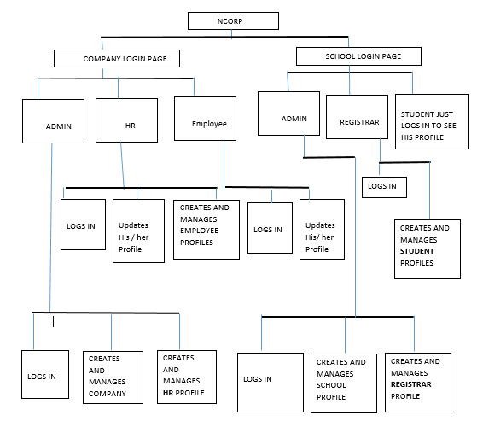
FUNCTIONAL DECOMPOSITION DIAGRAM

Slide 24
WEBSITE
VM : SRV1

Slide 25
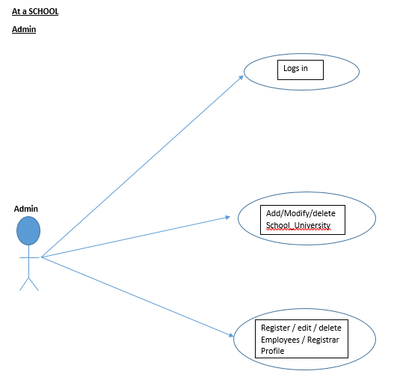
USECASE

Slide 26
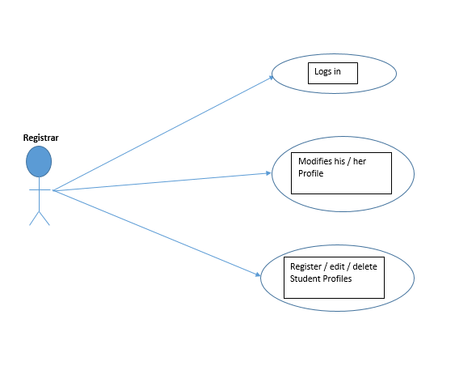
USECASE

Slide 27
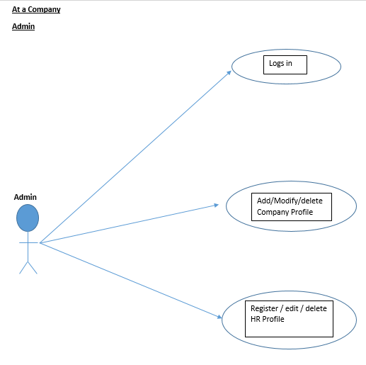
USECASE

Slide 28
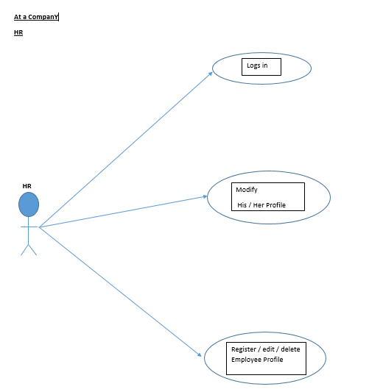
USECASE

Slide 29
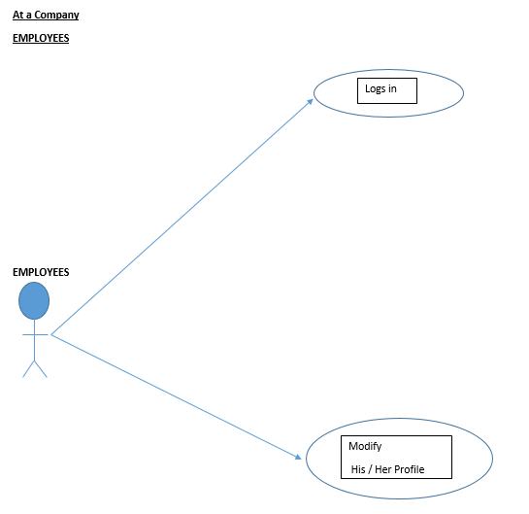
USECASE

Slide 30
ERD

Slide 31
OWASP – ESAPI TESTING
Information Gathering & Conducting Search engine discovery and Reconnaissance for information leakage
Ping of death
Fingerprint web server
Enumerate application on Webserver
Fingerprint web application
Testing Identity Management
Authentication Testing
Authorization Testing:

Slide 32
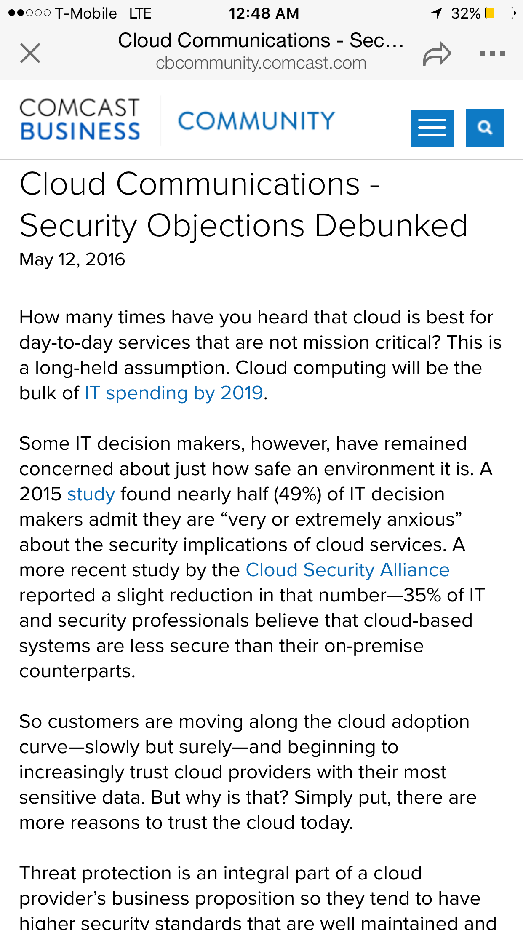
FUTURE ENHANCEMENTS
PROBLEM WITH CLOUD : SECURITY

Slide 33
FUTURE ENHANCEMENTS
To create EC2 Windows and Linux instances with Amazon web services to reduce the infrastructure and to improve performance.
To redesign the Website with more security controls: Validation Controls
To Save the Web application data to Amazon DynamoDB
To Review of Webserver metafiles for information leakage:

Slide 34
CONSLUSION
Security is not a state to achieve but it’s a continuous process.

